Slide 1
HW1
explain polar coordinates
2. display your 4 params animals
3. do South CN morning post scrape etc.
Xuxin Yi Ziyue Qin

Slide 2
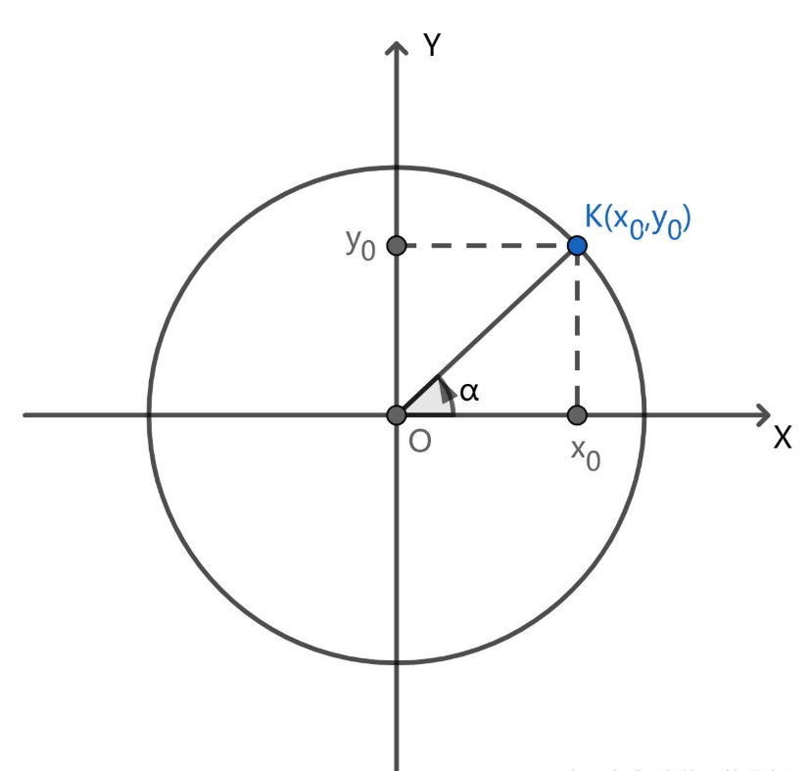
1. explain polar coordinates
Polar coordinates are a two-dimensional coordinate system in which each point on a plane is determined by a distance from a reference point (called the pole) and an angle from a reference direction (usually the positive x-axis). In mathematical terms, a point in polar coordinates is represented as (r,θ), where r is the radial distance from the pole and θ is the angular coordinate.
To convert from Cartesian coordinates (x,y) to polar coordinates:
An application of polar coordinates is in physics when dealing with circular motion. For example, if an object is moving in a circle around a point, we can describe its position at any given time using the distance from the center of the circle ( r ) and the angle it has swept from a particular starting direction ( θ ).

Slide 3
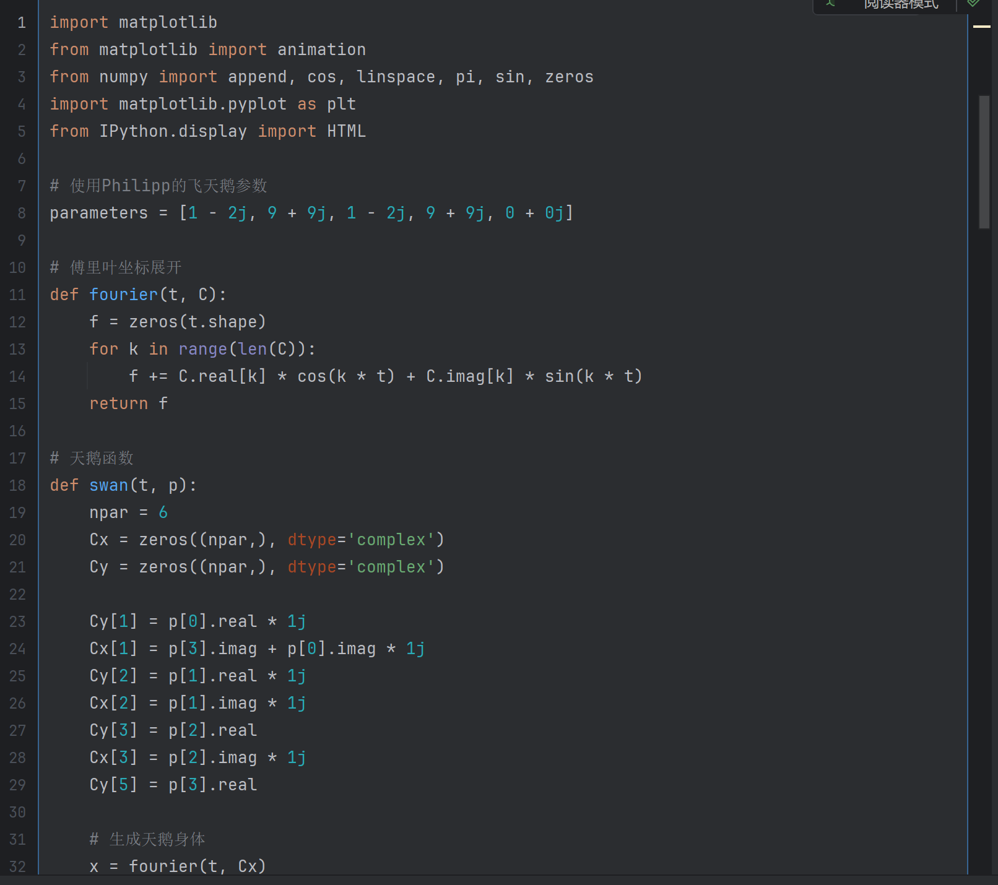
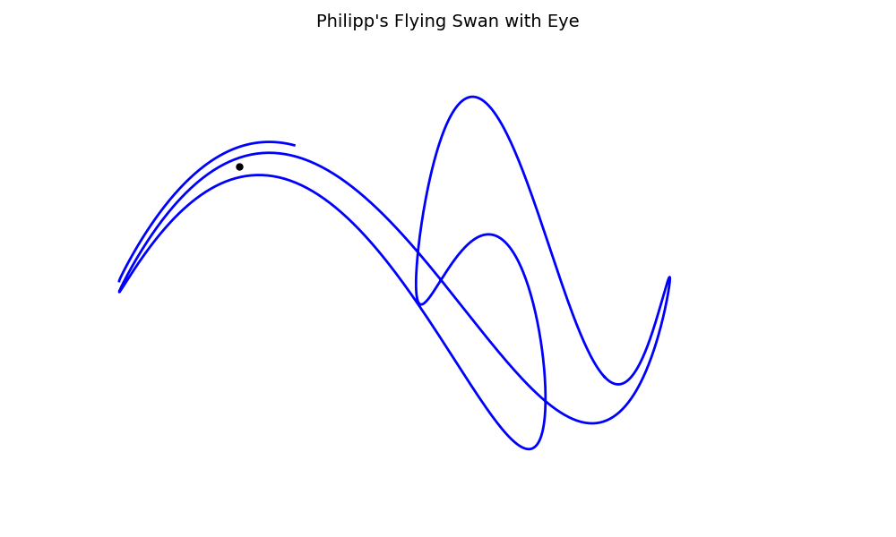
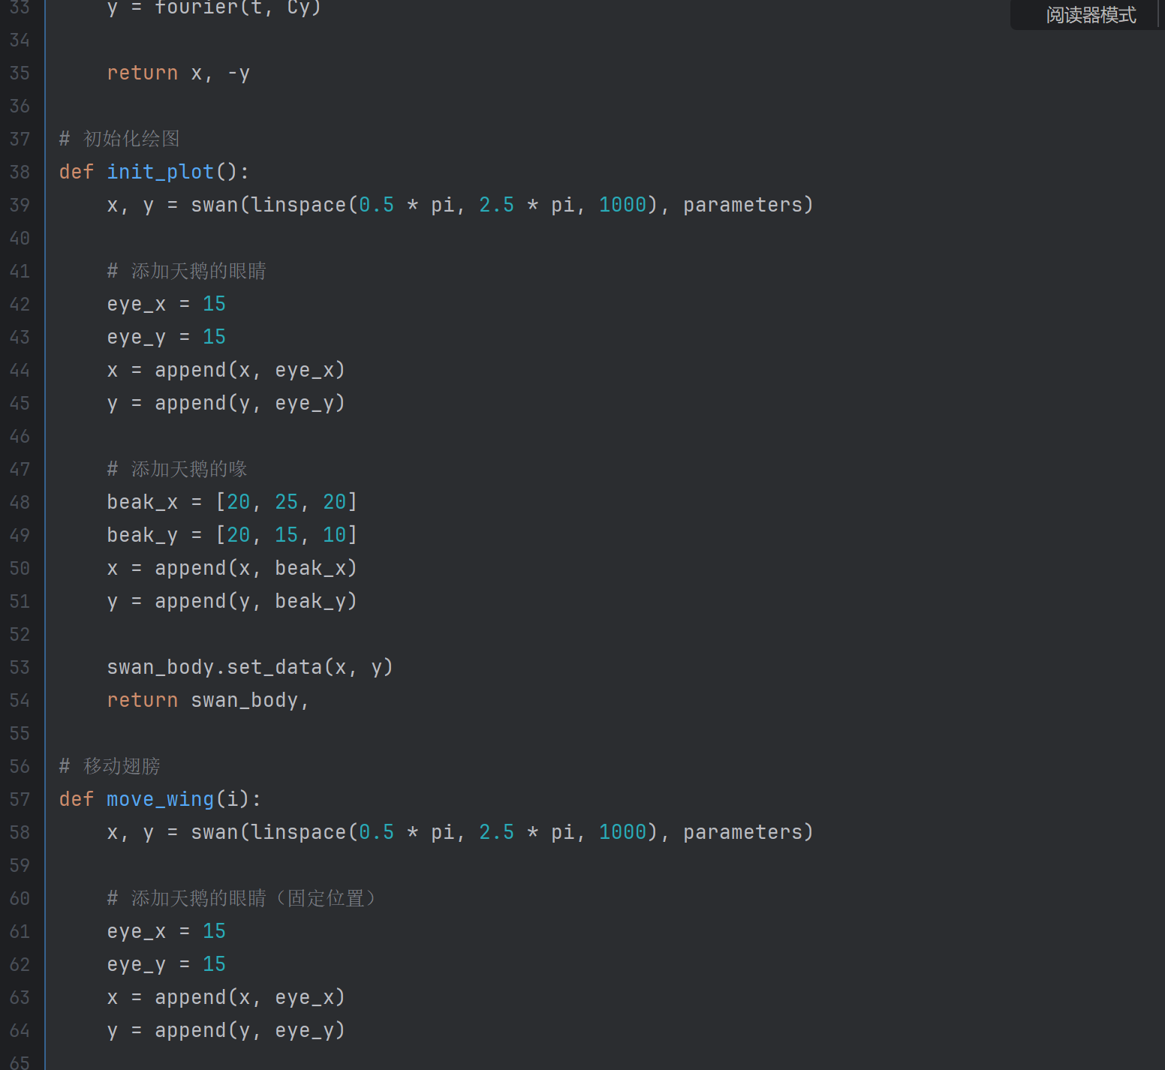
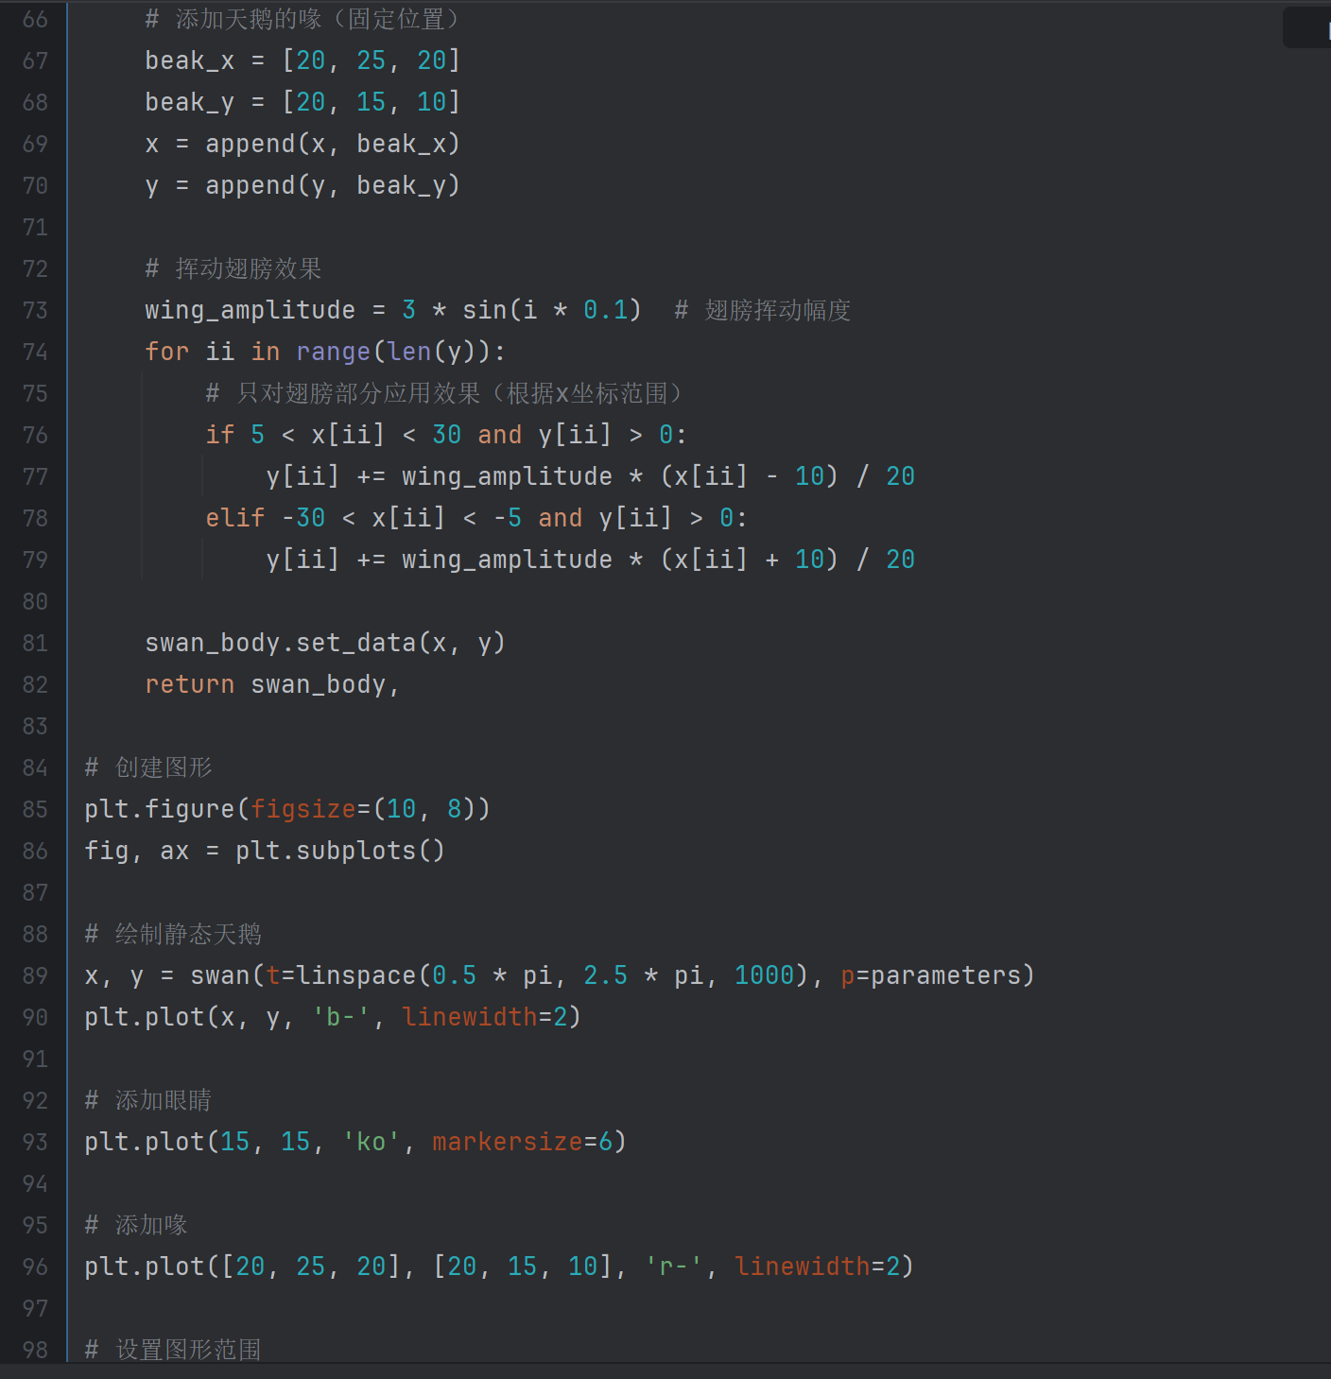
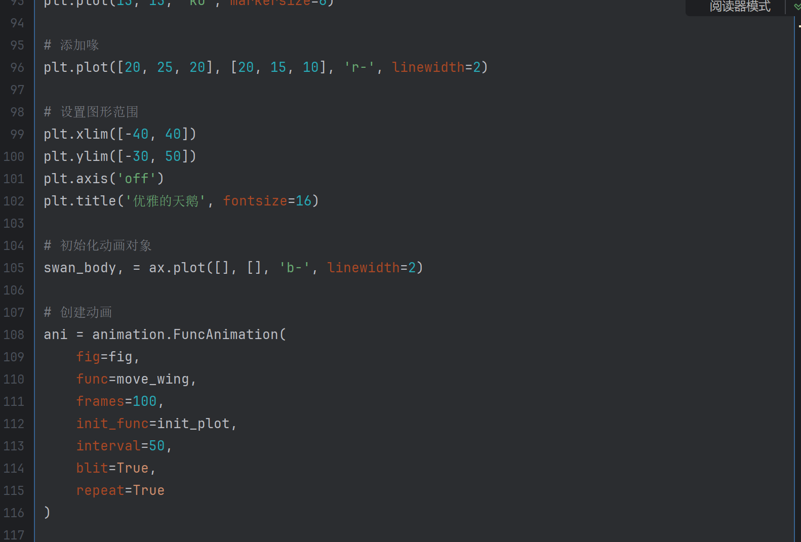
2. display your 4 params animals

Slide 4
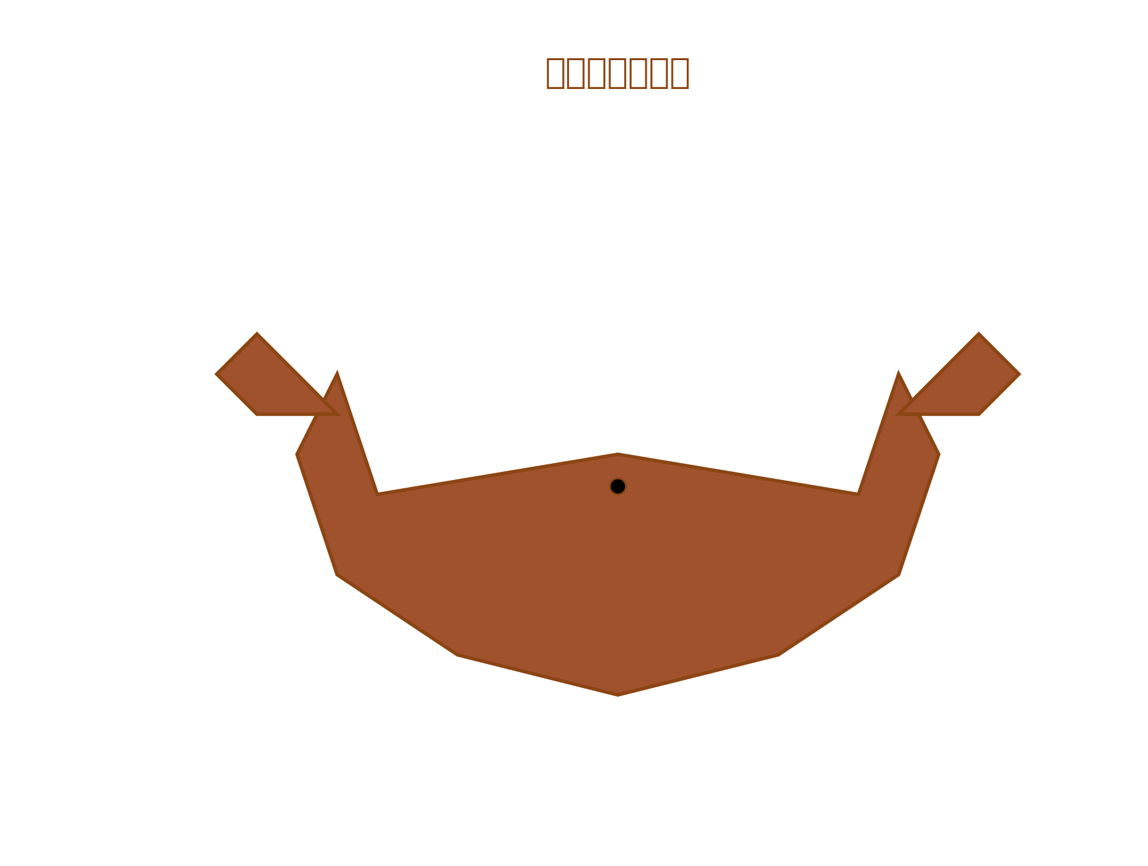
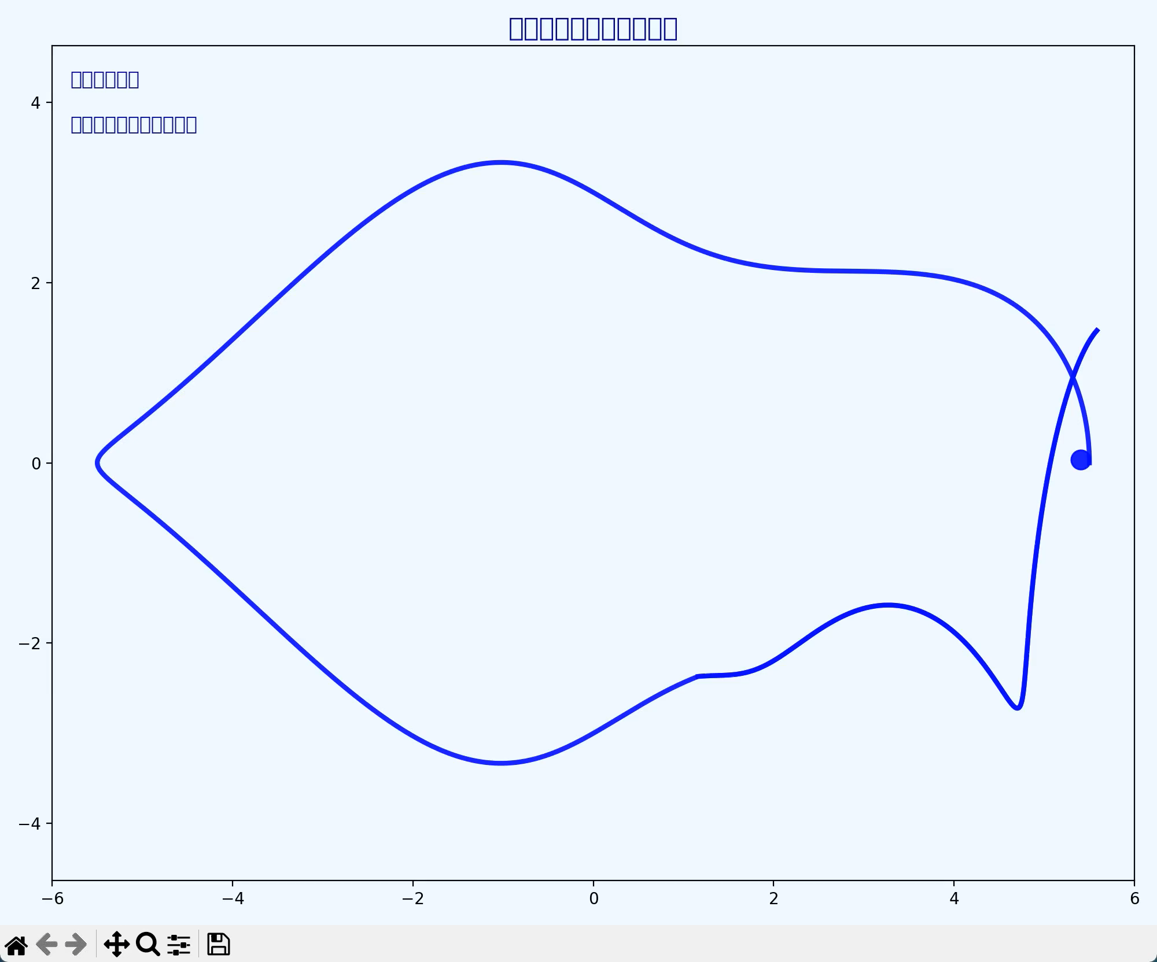
2. display your 4 params animals

Slide 5
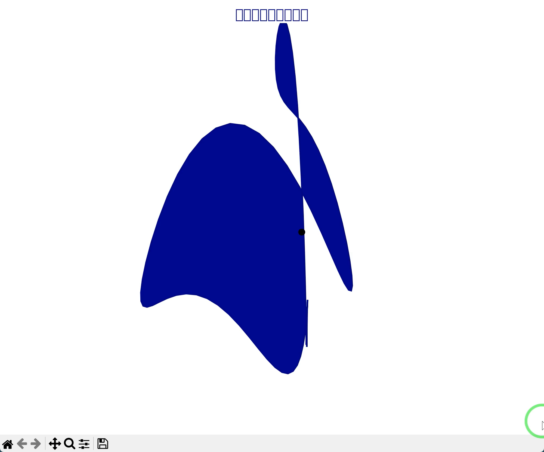
2. display your 4 params animals

Slide 6
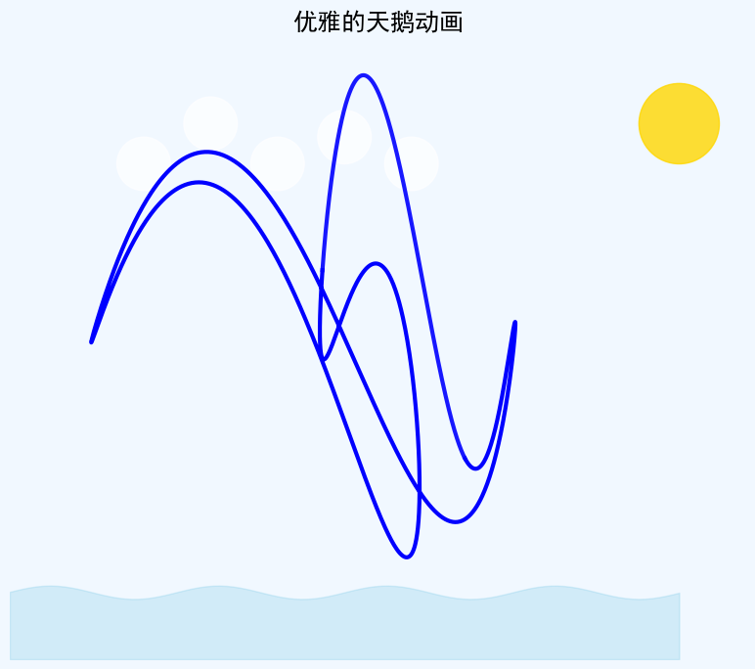
2. display your 4 params animals

Slide 7
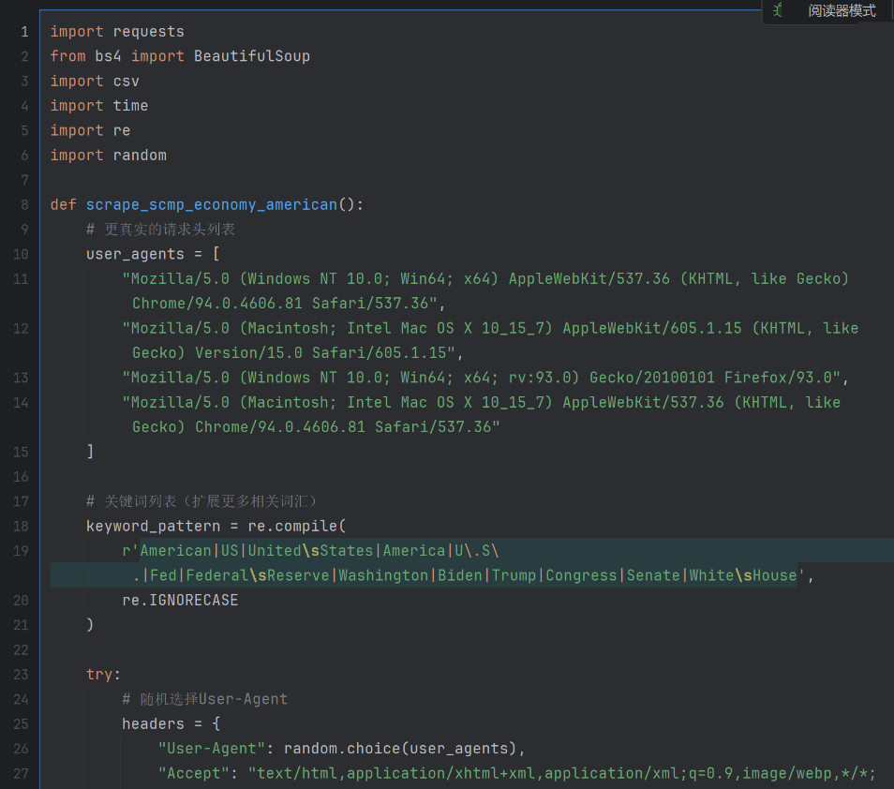
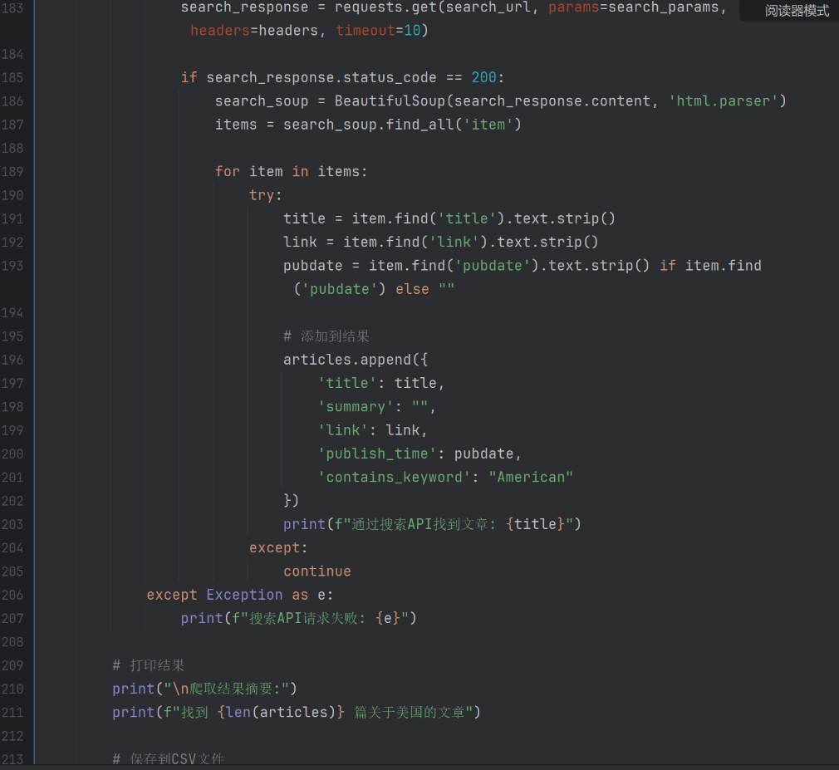
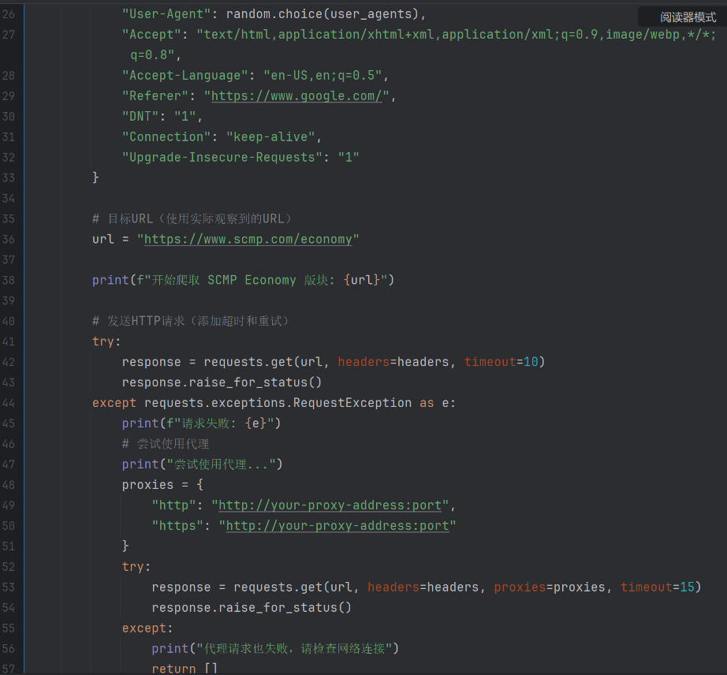
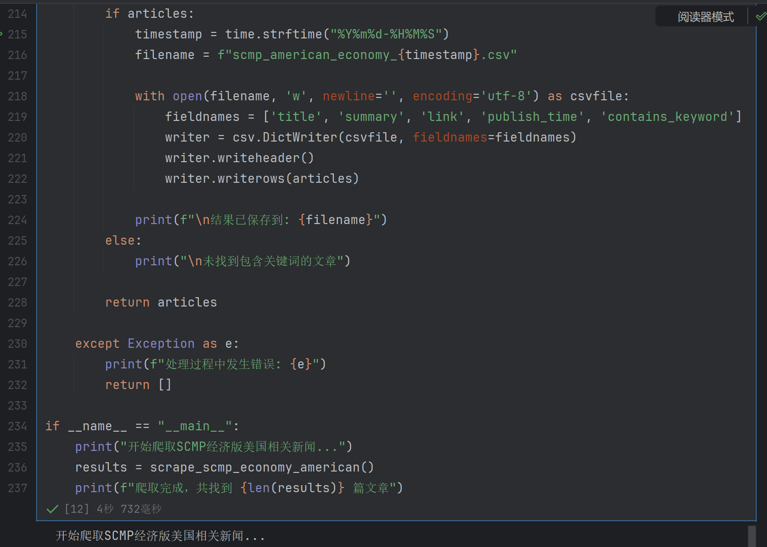

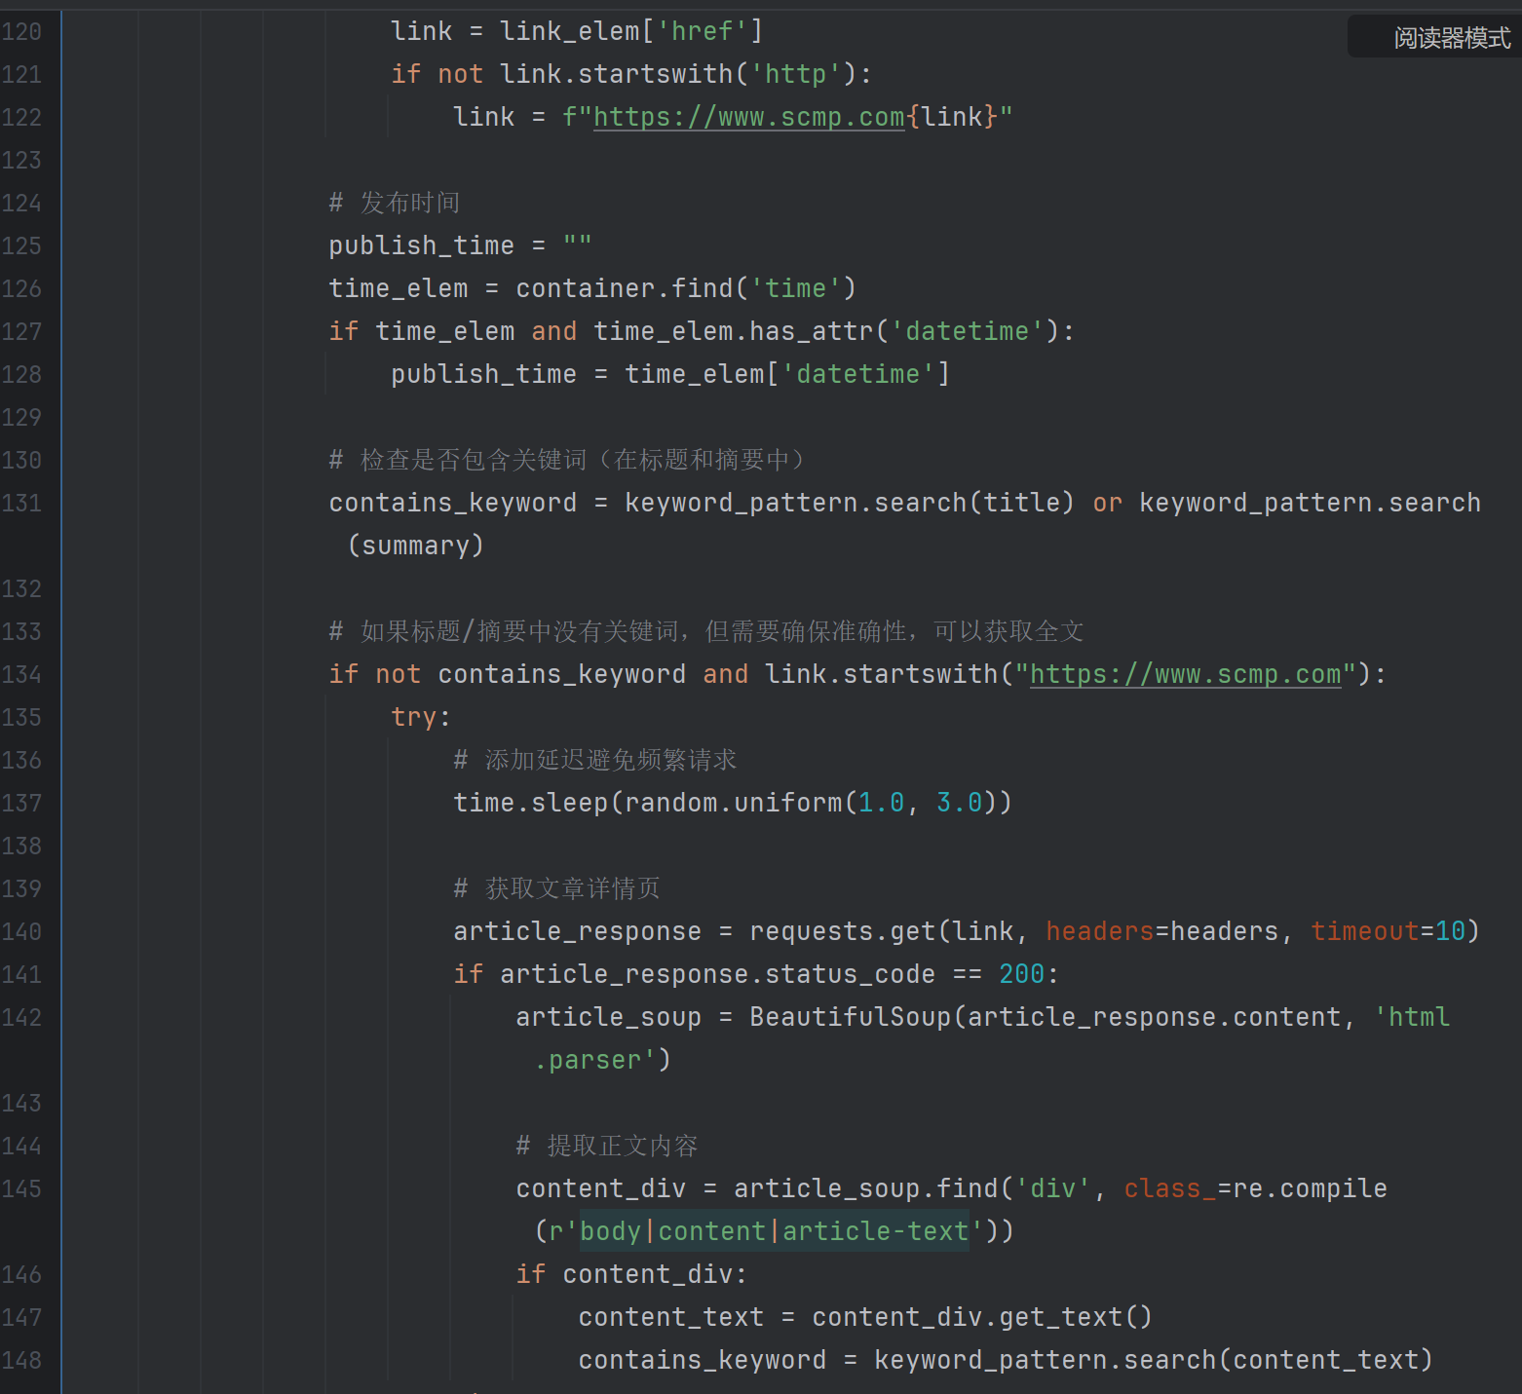
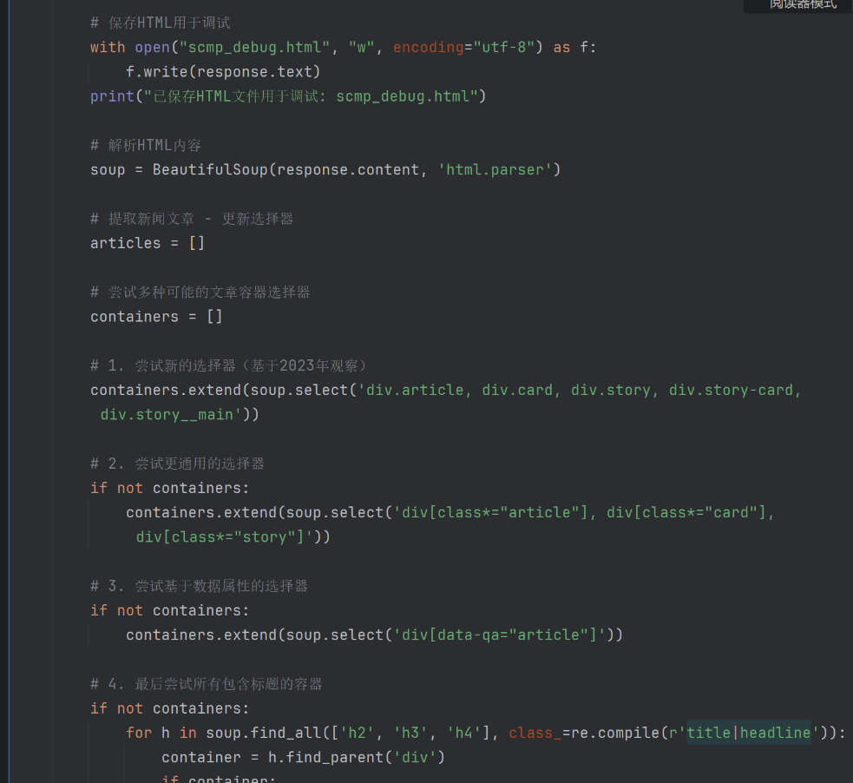
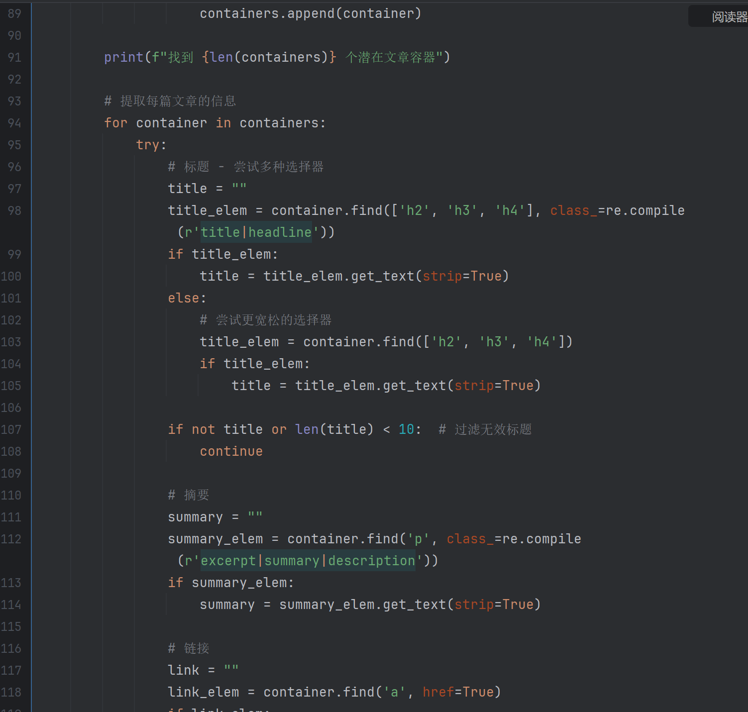
3. do South CN morning post scrape etc.

Slide 8
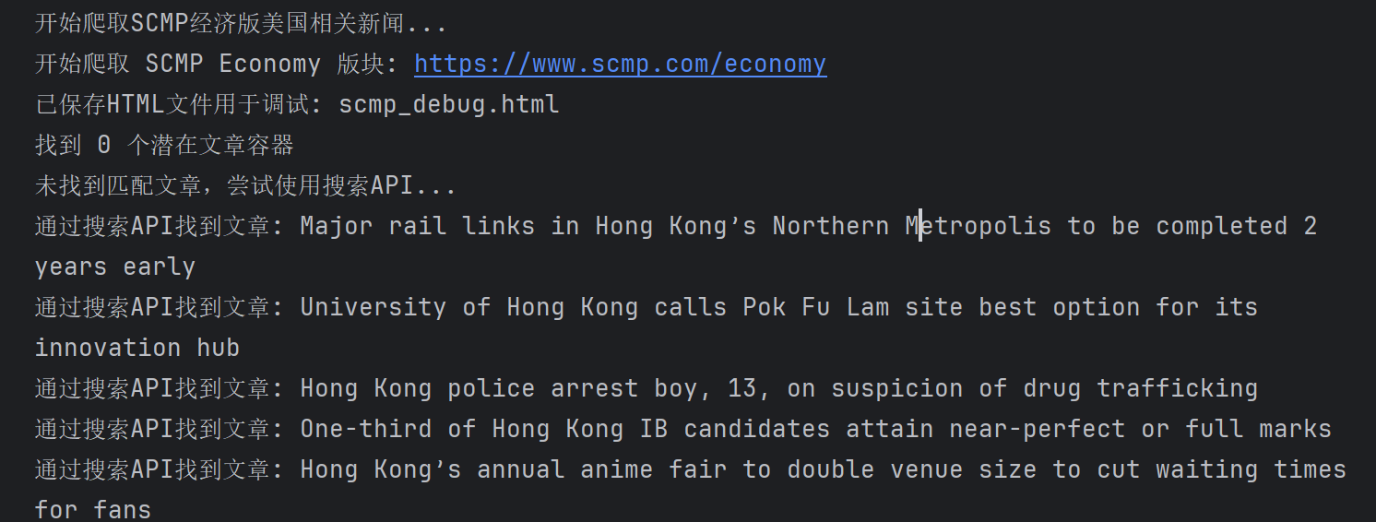

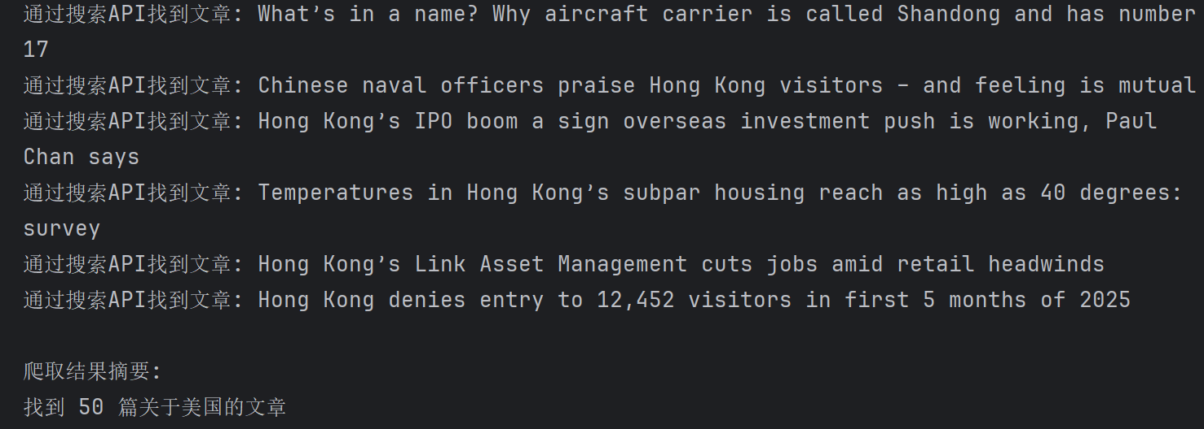

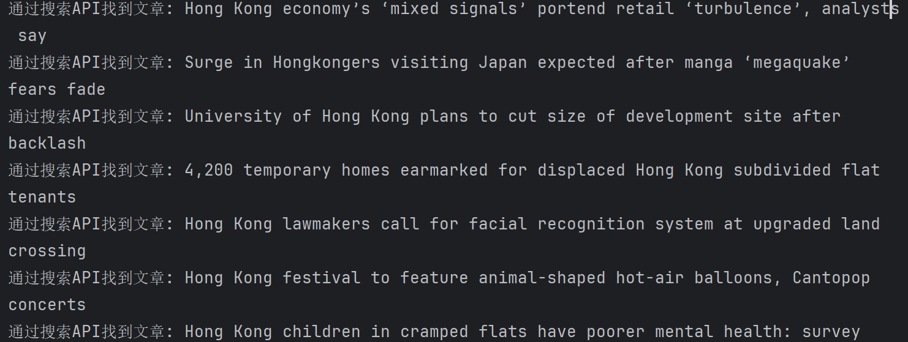
3. do South CN morning post scrape etc.

Slide 9
Thanks And Your Slogan Here

